Slide 1
ADT Alert and Transfer System
By Tanisha Robinson and Yolanda James
Cis 280
Systems analysis and design

Slide 2
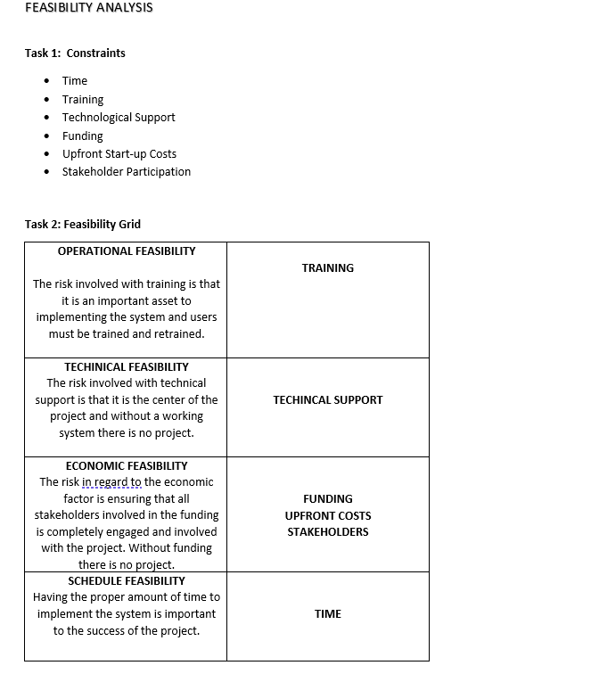
Object Modeling /Feasibility
In this analysis, we learned about the four types of feasibility and their involvement in a project. Also helping us break down and categorize our constraints.

Slide 3
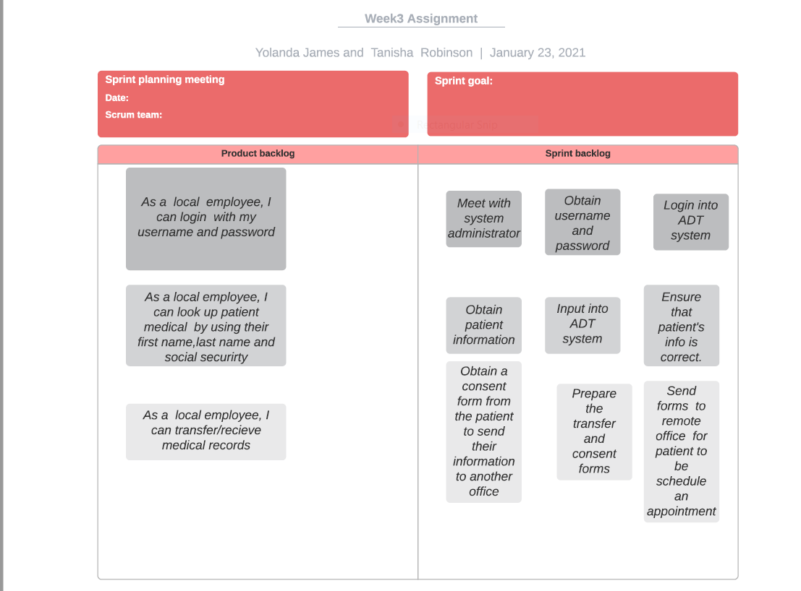
Project Plan
In this analysis, we learned what can be achieved. We learned that it’s divided into two parts; Product backlog where the vision of the project is shared, and Sprint backlog is where a list of tasks that are to be completed.

Slide 4
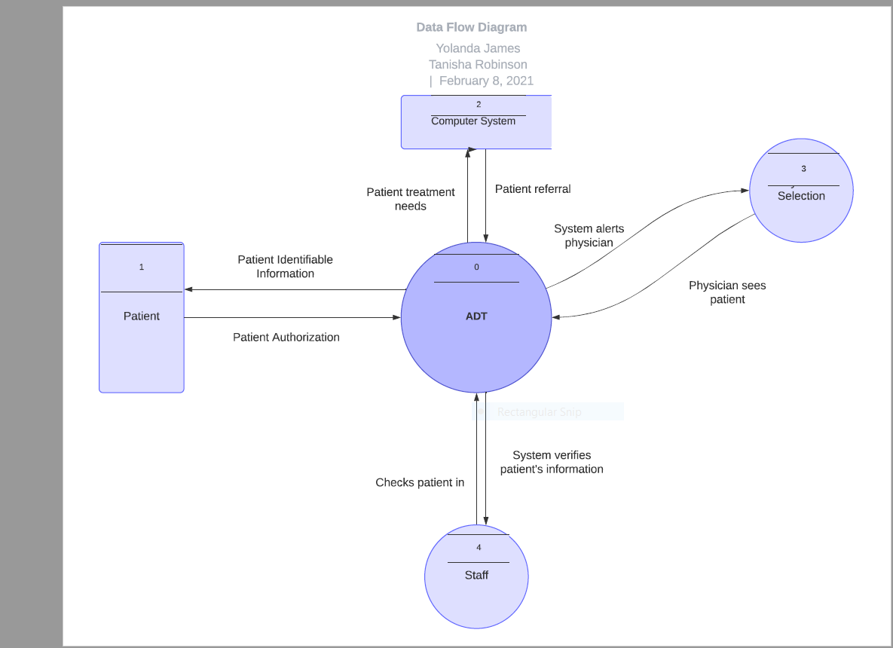
Requirement Models
In this diagram, we learned how data flows throughout our system. We learned that data flow can be divided in physical and logical aspects.

Slide 5
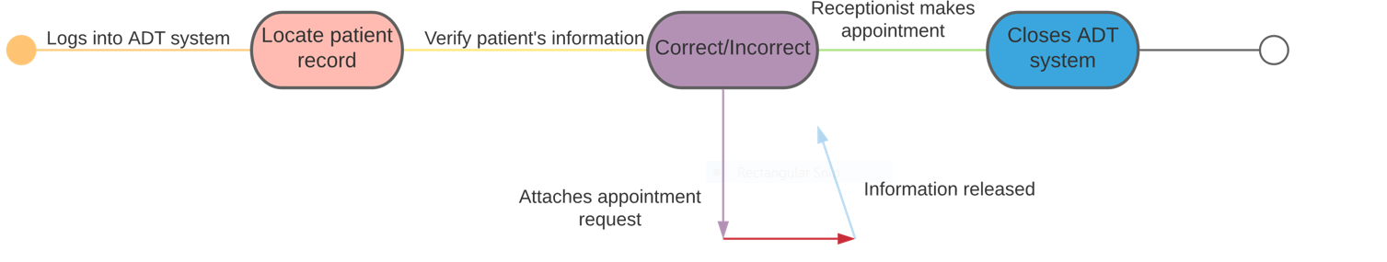
Object Modeling/Transition Diagram
In this diagram, we learned how objects changed from one state to another. Also, the flow and communication between each user.

Slide 6
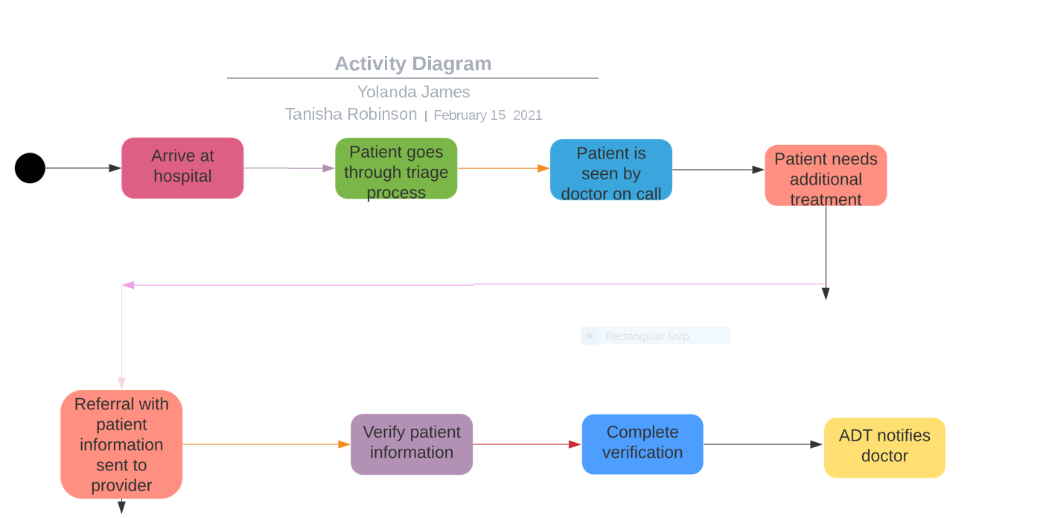
Object Modeling/ Activity diagram
In this diagram, it showed us the flow of activity from the time the patient enters the hospital. This helped us get an outline of how the system including the technology portion ill flow.

Slide 7
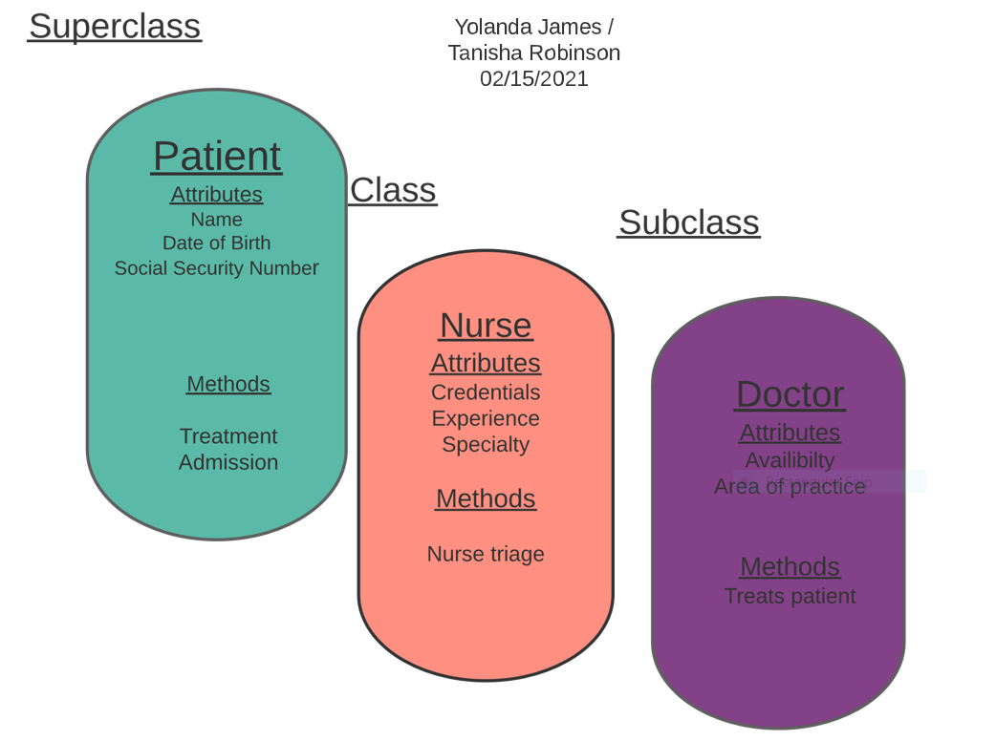
Object Modeling/ Superclass, Class and subclass
Using this diagram, we learned about the superclass, class, and subclass. We learned about the different attributes and methods related to each class.

Slide 8
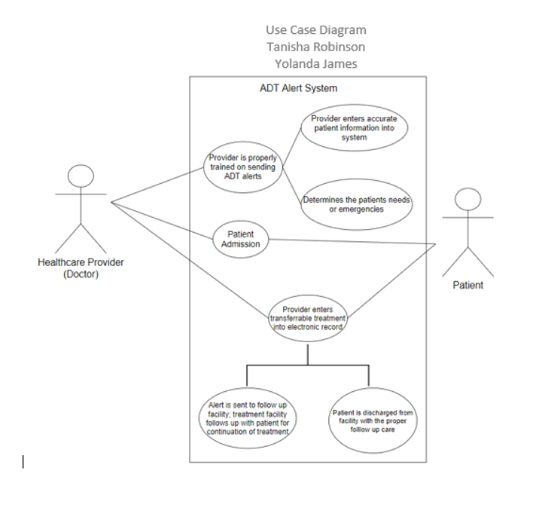
Object Modeling/Use Case
In this diagram, we learned how our project’s system uses actors and user cases to capture the functionality as well as the connection and communication of a system.

Slide 9
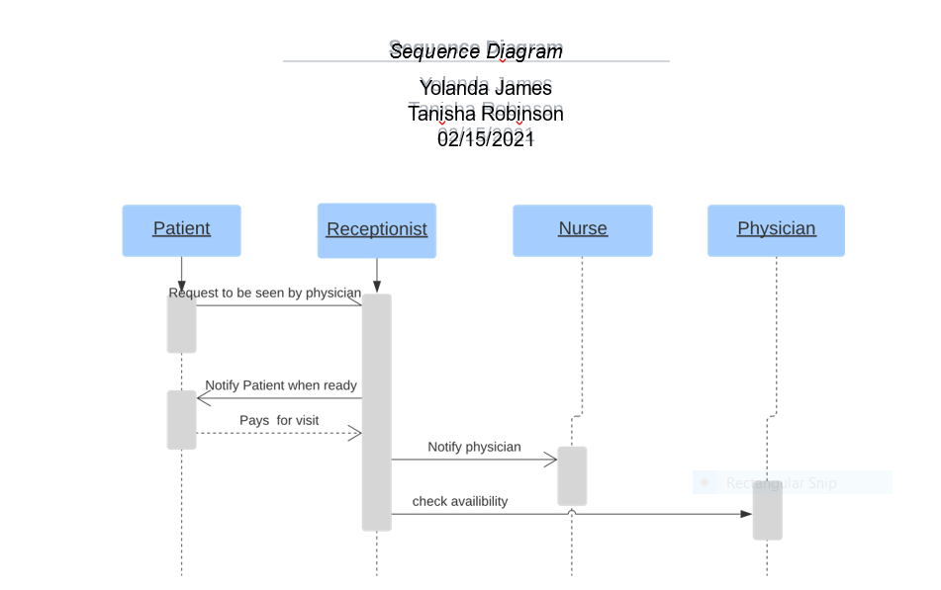
Object Modeling / Sequence Diagram
In this diagram, we learned about the components and the interactions between objects. Sequence diagrams also showed us how operations are carried out.

